Slide 1
Equipment Aids of My Dreams
Joan Dunham

Slide 2
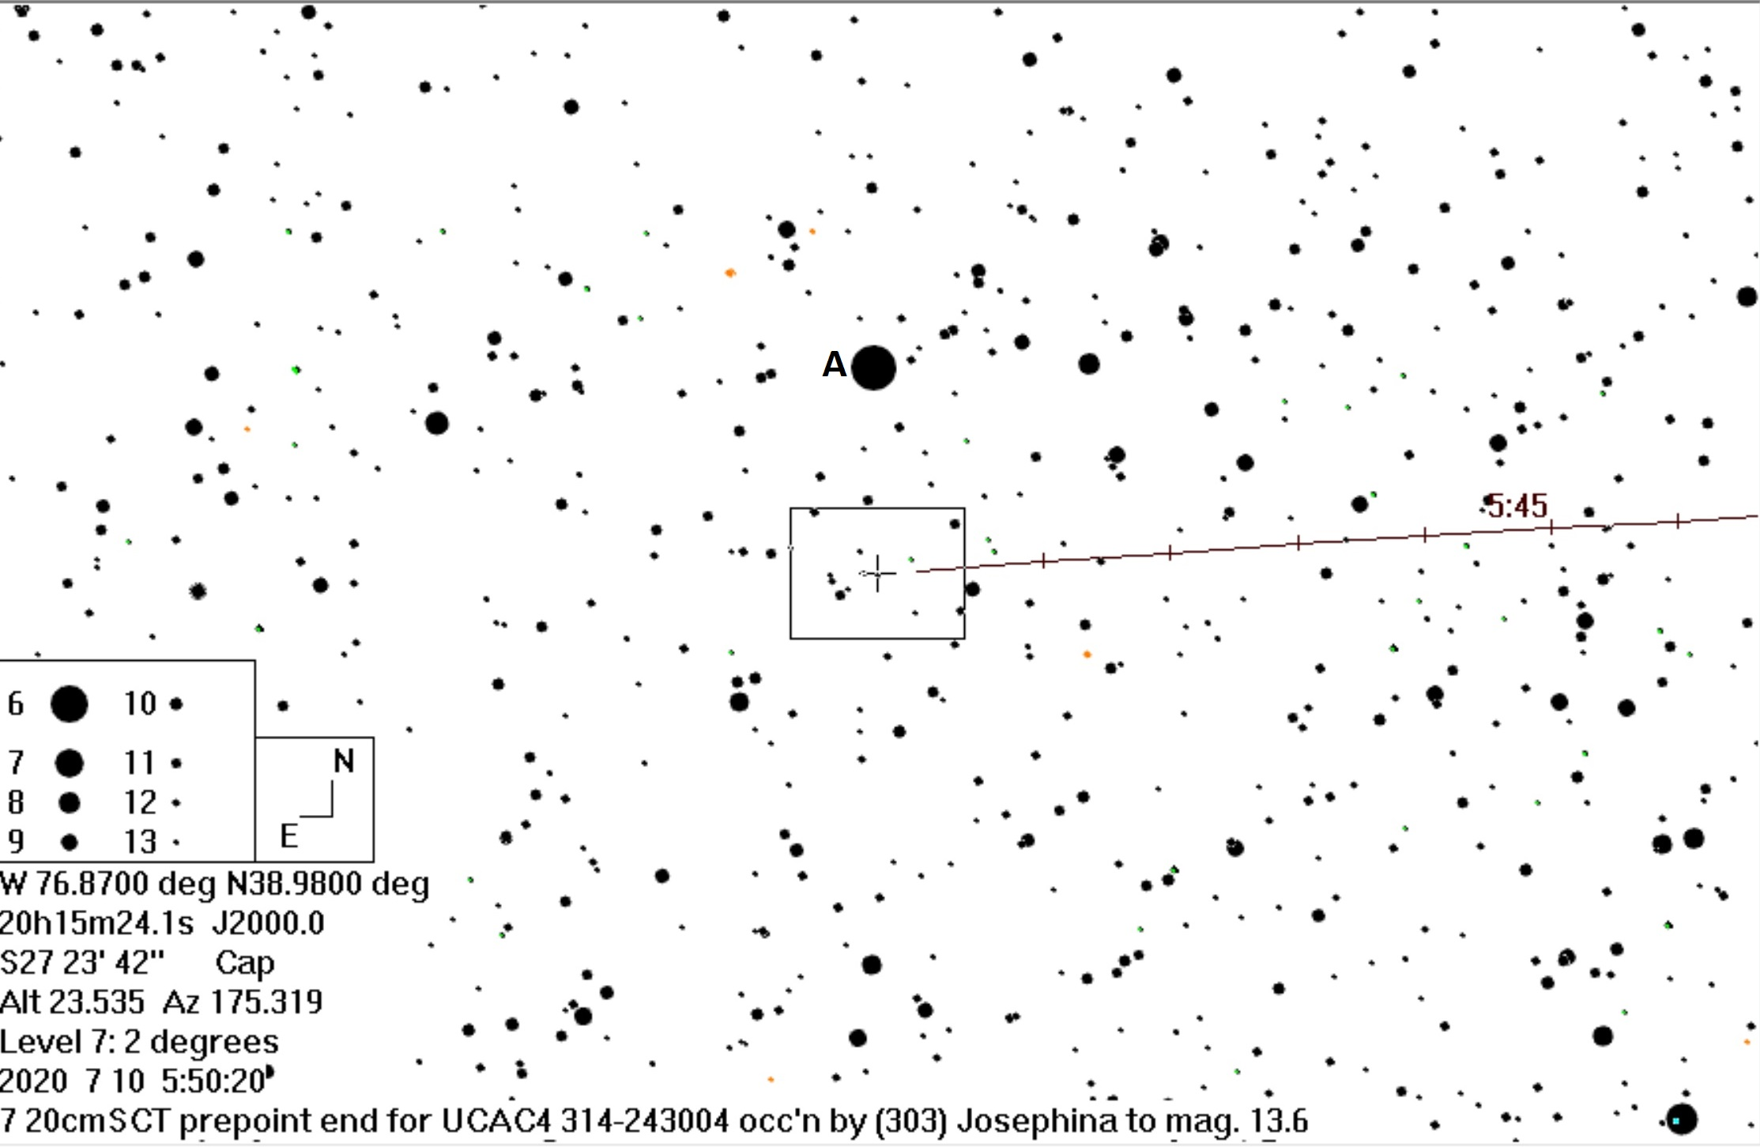
Desirable Observing Aids
Enhanced prepoint finder charts
On a laptop or tablet instead of paper
Night mode lighting
Screen display progresses with time as the event approaches
Drill-down through displays to get to finer and finer detail
Display customizable to match screen display or FOV of scope
Ability to configure Windows computer to be better at data capture
Provide option for “stripped” mode, removing apps not needed for data capture
Maximize data capture priority
Batteries that are easily replaced

Slide 3
Camera Wishes
Camera with IOTA VTI-like GPS capability
Increased sensitivity
Weather (dew) resistant
Inexpensive
On-board temporary capture to minimize dropped frames
Possible scenario for current camera designs upgrade
Data time-tagging and temporary storage between camera and capture computer
Allows high speed data capture which is then forwarded as the capture computer can accept it

Slide 4
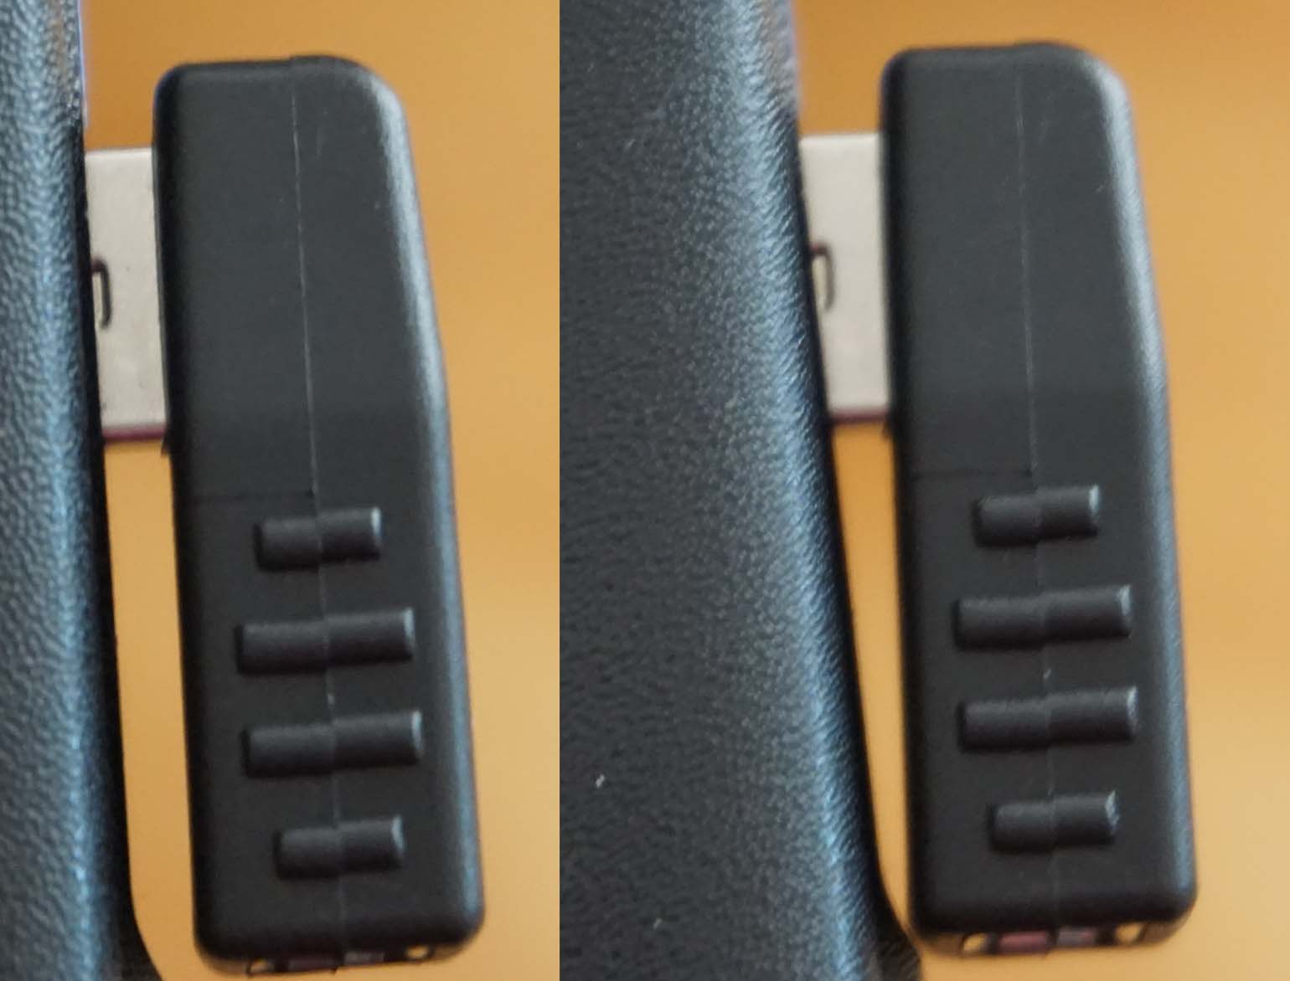
USB Comments
USB standard emphasizes ease of use and low expense , not precision
Issues like these
Short USB receptacle, long USB plug
Short USB plug, long USB receptacle
Loose fitting USB plug, falls out
Tight fit, plug can damage receptacle
USB 3.0 standard does not specify a maximum cord length but the maximum practical length for copper wiring to meet the electrical specs is 3m (9.8 ft)
USB tester – like the Eversame USB Type C tester - helps in resolving problems
Occasional poor communication when this plug, which is a little too long for the receptacle, is not straight.

Slide 5
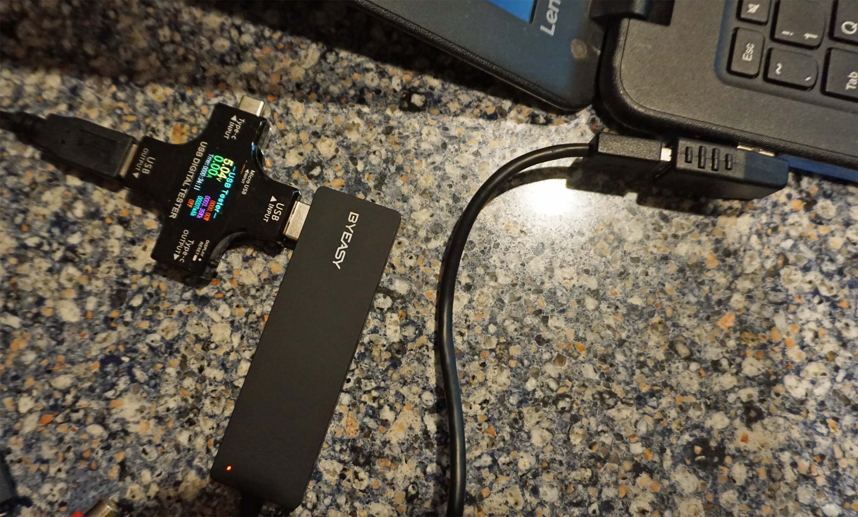
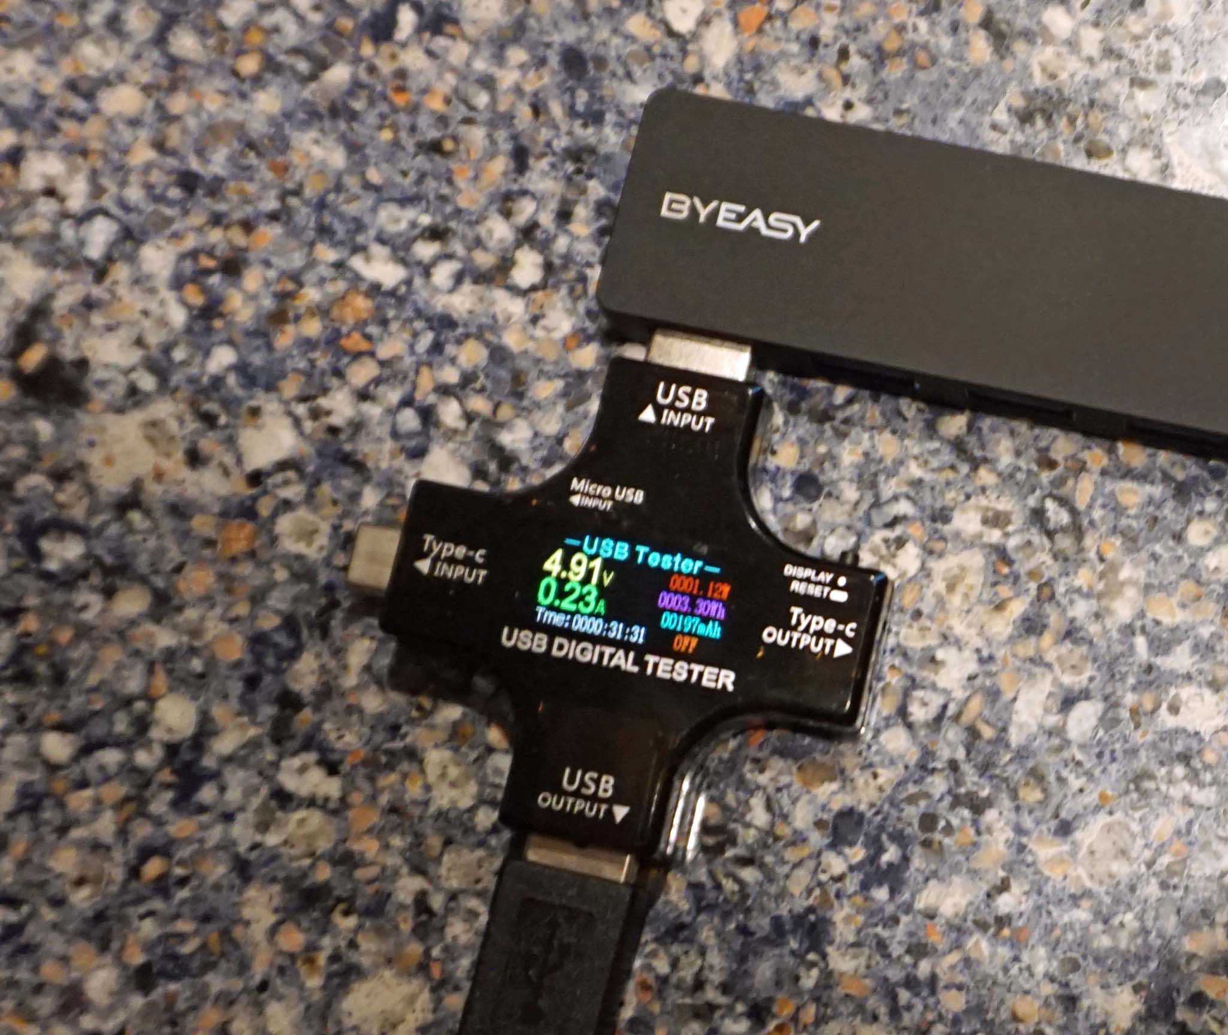
USB Digital Tester
Communication – the amps are >0.
No communication – note the amps are shown as 0.

Slide 6
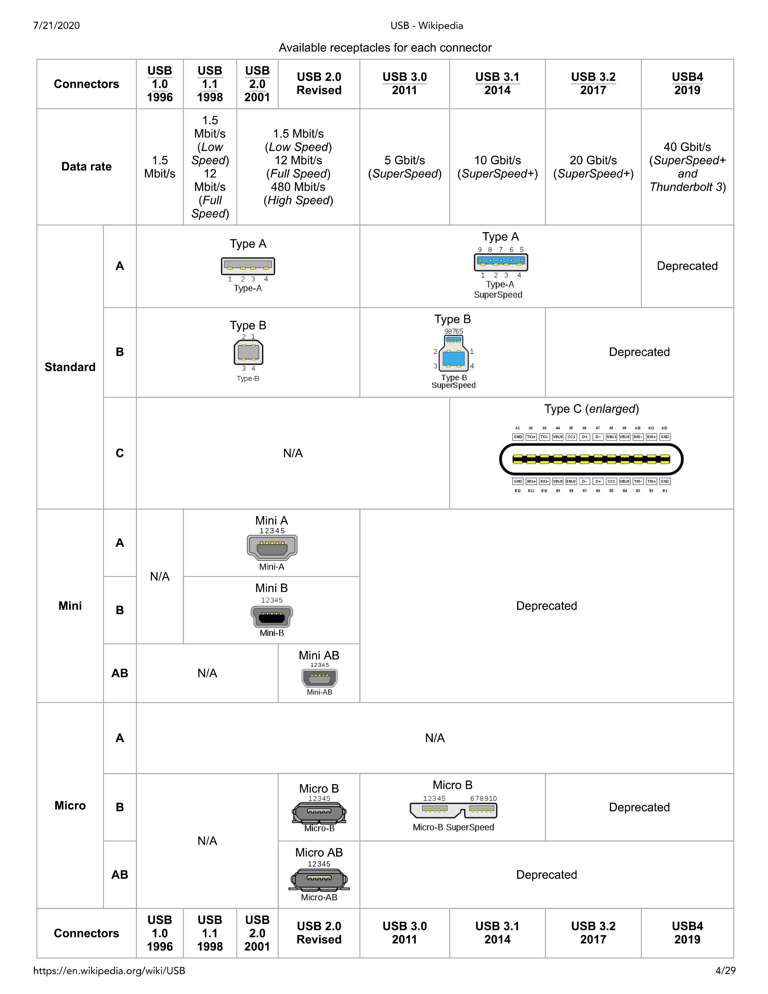
USB specifications overview from Wikipedia
USB 2 has 4 pins, all on one side
USB 3.0-3.2 has 9pins, 4 on one side, 5 on the other
USB C has 24 pins, 12 per side
The QHY-174 camera USB receptacle is Type B USB 3. This type of connector will not be an option for higher speed USB 3.3 or USB 4.
USB C is shown as for USB 3.1 and higher. But some early designs may have only implemented USB-2 options in a USB C plug/receptacle.
Note that, in the future, everything but the Type C USB connector is deprecated. In the future we can discard our various cords with different connectors as well as multiple types of adaptors. Also, since the USB C is used for power cords, we no longer will need separate power cords for each device.

